Slide 1
Holbrook Regional Emergency Communications Center
FY25 Select Board and FinCom Budget Presentation

Slide 2
Agenda
Introduction
Department Overview
Review of 2023
Call Volume CY2023
CY23 and FY24 Accomplishments
FY25 Roadmap

Slide 3
Introduction
What is the organizational structure of the HRECC?
What are the primary roles and responsibilities of the team at the HRECC?
Who are our current partner communities?

Slide 4
Organizational Chart FY24 (funded positions)
Director of Communications
Deputy Director of Communications
IT Network Coordinator
FT Administrative Assist.
Training Coordinator
Group A Supervisor
Group B Supervisor
Group C Supervisor
Group D Supervisor
FT Telecomm 8 per group
FT Telecomm 8 per group
FT Telecomm 8 per group
FT Telecomm 8 per group
PT Telecomm 1 per shift 8-4 & 4-12
PT Telecomm 1 per shift 8-4 & 4-12
PT Telecomm 1 per shift 8-4 & 4-12
PT Telecomm 1 per shift 8-4 & 4-12
Assistant Director of Communications
QA/QI Analyst
Operations Manager
Lead Telecommunicator 1-2 per group
Lead Telecommunicator 1-2 per group
Lead Telecommunicator 1-2 per group
Lead Telecommunicator 1-2 per group
PT IT Network Coordinator
Interoperability Coordinator

Slide 5
Organizational Chart FY25 (includes proposed positions)
Director of Communications
Deputy Director of Communications
IT Network Coordinator
FT Administrative Assist.
Training Coordinator
Group A Supervisor
Group B Supervisor
Group C Supervisor
Group D Supervisor
FT Telecomm 11 per group
FT Telecomm 11 per group
FT Telecomm 11 per group
FT Telecomm 11 per group
PT Telecomm 1 per shift 8-4 & 4-12
PT Telecomm 1 per shift 8-4 & 4-12
PT Telecomm 1 per shift 8-4 & 4-12
PT Telecomm 1 per shift 8-4 & 4-12
Assistant Director of Communications
QA/QI Analyst
Operations Manager
Lead Telecommunicator 1-2 per group
Lead Telecommunicator 1-2 per group
Lead Telecommunicator 1-2 per group
Lead Telecommunicator 1-2 per group
PT IT Network Coordinator
Interoperability Coordinator
Addition of three Telecommunicators per group due to additional community partnerships

Slide 6
Current Staffing
Contract Employees (5) – Director of Communications, Assistant Director of Communications, Deputy Director of Communications, Operations Manager, IT Network Coordinator
AFSCME Union Employees (46) – Training Coordinator, Interoperability Coordinator, QA/QI Analyst and all Supervisor, Lead and Full-Time Telecommunicators
Wage & Salary Employees (13) – Part-Time, non-benefitted employees
International Union of Public Employees Clerical Union (1) – One Full-Time member to absorb all clerical functions

Slide 7
Responsibility of the Team
The members of HRECC are responsible for answering 911 calls, providing Emergency Medical Dispatch (EMD) which includes pre-arrival instructions; dispatching the appropriate police, fire and EMS units to calls for service; maintaining detailed logs in CAD; coordinating mutual aid responses. We have several Communications Training Officers (CTOs) on staff to assist with the training of new employees. We are mandated to perform QA/QI on a minimum of 7-10% of medical calls. Additionally we have members of the department assigned to various field response agencies to provide communications support such as MetroLEC, TERT and the Norfolk County Tech Rescue Team.

Slide 8
Proudly Serving the Towns of:
Abington (Police, Fire, EMS, PSAP
Canton (Fire, EMS)
Holbrook (Police, Fire, EMS, PSAP)
Holliston (Police, Fire, EMS, PSAP – January ‘24)
Norwood (Fire & PSAP March ‘23, Police August ‘23)
Rockland (Police, Fire, EMS, PSAP)
Sharon (Fire, EMS)
Sherborn (Police, Fire, EMS, PSAP)
Stoughton (Fire & PSAP Oct. ‘23, Police February ‘24)
Whitman (Fire, EMS and Primary PSAP)
Norfolk County Control - County Control Point for Fire District 4

Slide 9
Welcoming the Following Communities in FY25
Fairhaven (Police, Fire and PSAP)
Sudbury (Police, Fire and PSAP)
East Bridgewater (Police, Fire and PSAP)

Slide 10
Current Population Served

Slide 11
Projected Population Served in FY25
Total Population Served in FY25:
233,920

Slide 12
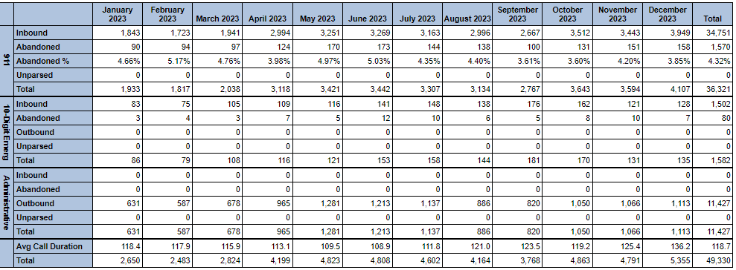
911 Call Volume CY2022

Slide 13
Call Volume & Calls for Service CY2023
911 call volume increased by 17,439 calls in CY23 over CY22 which is a 35.35% increase
Total calendar year 2022 calls for service was 112,785 which is a 74.46 % increase over CY22 and % increase over CY21. These calls for service are generated as a result of a 911 call, call to the business lines or initiated by a responder.

Slide 14
HRECC Network Topology
COLOR LEGEND
Red – Microwave
Orange – Comcast Metro LAN
Yellow – Fiber
Purple – FDDA Circuits
Green – Future Connection
Blue – Microwave Owned by Others

Slide 15
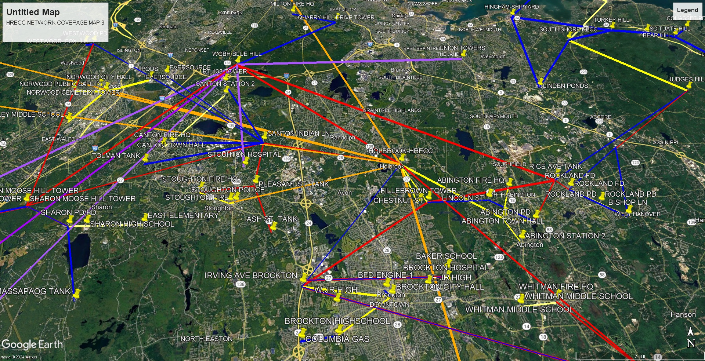

Slide 16
HRECC Network Statistics
Number of Tower/Equipment Sites Operated by HRECC | 56
Number of Tower/Equipment Sites Shared | 106
Number of Future Tower/Equipment Sites Pending | 10
Number of Communities Directly Connected | 26
Number of Radios that Communicate Through HRECC Network | 10,661

Slide 17
Communities with Direct Connections to HRECC Network
Abington | Marshfield | Sherborn
Brockton | Middleborough | Stoughton
Canton | Milton | Westwood
Cohasset | Norfolk | Weymouth
Foxborough | Norwell | Whitman
Franklin | Norwood | * Brookline
Hanson | Quincy | * Fairhaven
Hingham | Rockland | * Sudbury
Holliston | Scituate | * Pending Communities with
Hull | Sharon | Dir. Conn to HRECC Network

Slide 18
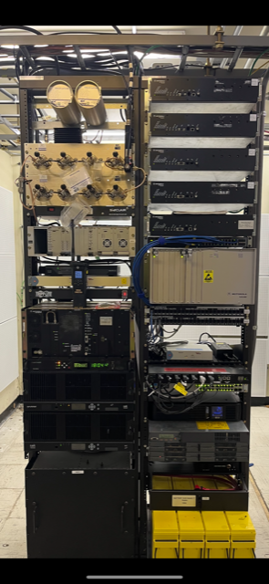
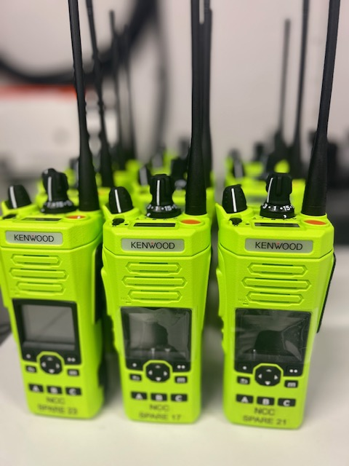
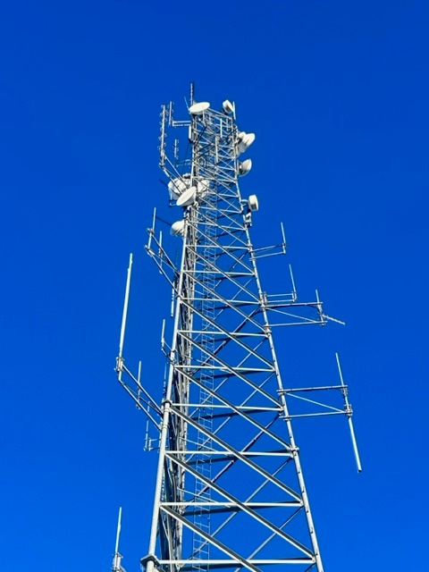
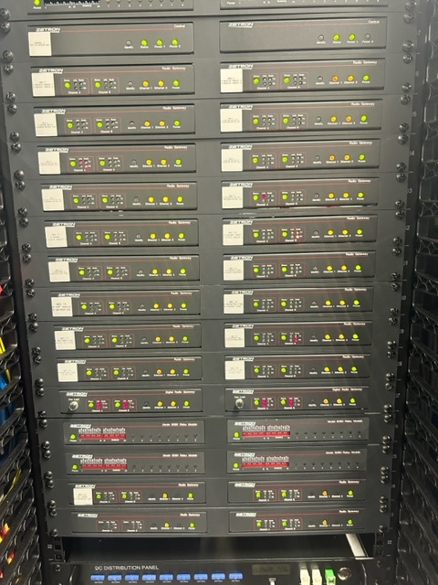
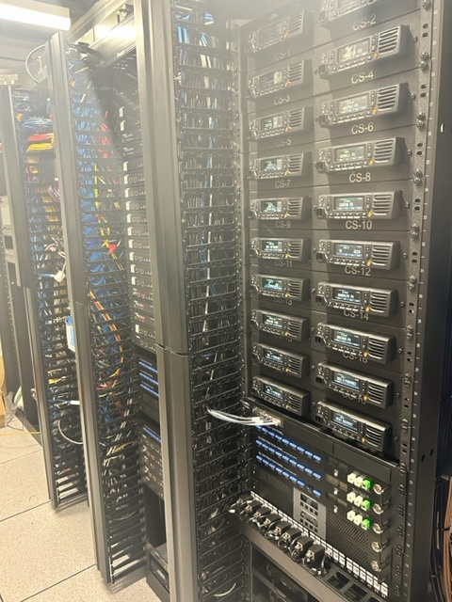
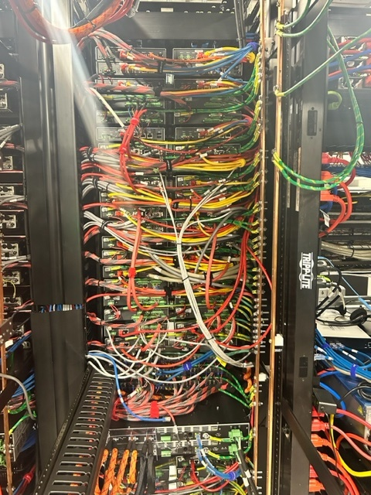
Examples of some of the radio equipment maintained by the HRECC at various sites/shelters

Slide 19
Department Accomplishments FY24
Successfully onboarded the communities of Norwood, Holliston and Stoughton. Entered into IMAs with three additional communities
Deputy Director received WIN (Women in 911) Scholarship
Operations Manager was nominated and awarded APCO Atlantic’s Supervisor of the Year
7 Telecommunicators were promoted to Lead Telecommunicator
6 Telecommunicators promoted to CTO
Obtained state funding to add console positions and technology to accommodate new communities
Installed fiber optic connections to multiple town buildings including: PSB, High School, Town Hall, DPW, COA
Moved Town Hall servers to HRECC server room for better oversight
Received Cybersecurity Grant for town employees to complete annual cybersecurity training

Slide 20
Fiscal Accomplishments FY24
Applied for, awarded and currently managing six (6) grants. Five (5) were awarded through the MA State 911 Department in conjunction with EOPSS, one (1) grant through the Office of Grants and Research.
Development Grant – $14,127,153.00
$2,267,596.00 – Transition expenses/assessment fees/security measure costs associated with the Towns of Rockland, Abington, Sherborn, Norwood and Holliston
$11,859,557.00 – Equipment expenses
Support & Incentive Grant – $2,599,845.00
$2,333,701.81 utilized toward salaries
$70,073.75 – CAD systems
$9,600.00 – Bi-annual console cleaning
$1,750.00 – Fire alarm receiving and alerting equipment associated with providing E-911 service
$154,427.76 - Public Safety Radio Systems
$30,291.68 – Other equipment – EvenTide NexLog recorder for Stoughton

Slide 21
Fiscal Accomplishments FY24 Cont.
Training Grant - $189,856.56
$74,866.00 – Fees associated with attendance at approved class/recert fees/membership & conference fees
$109,495.56 – Personnel costs associated with class hours to achieve and maintain certification
$5,495.00 – Pre-employment testing software annual fee
Emergency Medical Dispatch Grant – $5,999.76
EMDPRS (APCO IntelliComm)
TERT Grant - $101,336.00
Car Seat Program Grant – $791.20
GRANT TOTAL FY24: $17,024,981.52

Slide 22
Assessments Received
Town | Assessment Fee
Holbrook | $0 ($975,587.00 going back to Holbrook)
Sherborn | $312,966.00
Abington | $360,706.00
Sharon | $201,363.00
Whitman | $92,881.00
Canton | $290,570.00
Rockland | $336,013.00
Norwood | $772,500.00
Stoughton | $410,000.00
Holliston | $295,000.00
Sudbury | $295,000.00
Fairhaven | $295,000.00
TOTAL | $3,661,999.00

Slide 23
FY25 Revenue
FY25 Revenue: $3,661,999.00
State 911 Support Grant: $3,200,000.00 (Mostly salaries and some equipment)
Also now paid by HRECC:
Electric costs solely paid by HRECC: $120,000.00
IT expenses for Town and PSB: $133,500.00
Administrative assistant assumed by HRECC: $70,759.00
Full salary of IT Coordinator paid by HRECC: $85,274.00
Revenue returned to Town of Holbrook: Approx $975,587.00

Slide 24
Thank you
Thank you to the Holbrook Select Board and FinCom for your commitment to the Town of Holbrook and to the Holbrook Regional Emergency Communications Center
We value your partnership and appreciate your unwavering support of the HRECC
Stephan A. Hooke, Director of Communications
shooke@ncrecc.com

