Slide 1
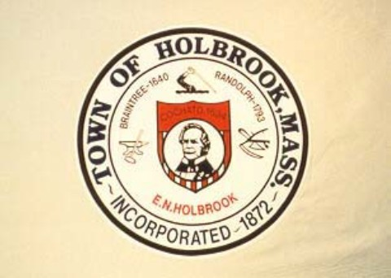
Report of the Finance Committee
TOWN OF HOLBROOK, MASSACHUSETTS FISCAL YEAR 2023 FINANCIAL REPORT & OPERATING BUDGET
General and Enterprise Funds
July 1, 2022, to June 30, 2023
Finance Committee
Patrick J. Duggan, Chairman
Michael Sigda, Vice‐Chairman
Brian McFarland, Clerk
Peter Mahoney
Susan Godwin
Scott McLellan
Andrea Piekarski
Barry Horne
Nakeya Miller

Slide 2
Table of Contents
Budget Message…............................................ | 3
Budget Calendar …........................................... | 5
Budget Graphs ….............................................. | 7
Appendix…...................................................... | 8

Slide 3
Budget Message
May 18, 2022
Dear Town Meeting Members:
We are pleased to present the Holbrook Finance Committee’s (FinCom’s) proposed Operating Budget, and related Enterprise Fund Budgets, for the Town of Holbrook for the Fiscal Year 2023 (FY23). As always, while preparing this upcoming year’s budget, FinCom did their best to distribute the town’s available resources to the areas of greatest need, while also maintaining services or mitigating any necessary service reductions in all departments. The ongoing coronavirus pandemic and the multiple unfilled positions at Town Hall were an atypical challenge for FinCom members, town department heads, and town leaders overseeing Holbrook’s finances in FY2022. However, due to the town’s fiscally prudent decisions, FinCom can once again present a balanced budget.
Despite the challenges that the town faced and keeping in mind that the future is always unknown and there are always hard decisions that the town must make, FinCom is happy to report that the town is currently in a position of fiscal strength. Over the past five years Holbrook dropped below the state’s average for a single-family tax bill¹ (currently 10% below the average). Holbrook is now ranked 158 out of 351 communities in that category of taxation, compared to 112 in 2018. We continue to contribute to our unfunded Other Post Employment Benefit (OPEB) liabilities, and our long-term debit obligations are decreasing – both of which are key factors in maintaining the town’s very favorable AA bond rating. Please note that we have included a few graphs related to these trends and Holbrook’s current financial position in the appendix at the end of this report for your perusal.
Due to an increase in expected revenues for FY23, our proposed budget – along with several warrant articles that are being presented at the Special Town Meeting (which is also being held on May 18) – addresses many overdue needs of the town. Several capital items, such as vehicles for the DPW and Public Safety Departments, building repairs for Town Hall and the town Library, and initial spending to establish a continuous road maintenance and repair program have been included. Despite these additional expenditures, this year’s proposed budget contains no staffing cuts, and funds each department’s requests at a level that would not only maintain their services, but would also, in many cases, increase the quality of their services.
That said, even with Holbrook in its current solid financial position, there are several upcoming, sizable, financial items that our town meeting members should be aware of heading into the new fiscal year:
New Water Plant – The Tri-Town water enterprise will be building a new water plant for the benefit of the residents of Holbrook, Randolph, and Braintree. Holbrook’s portion of the project will cost several million dollars, and the town should begin the necessary preparations to be able to pay our share. (Note: Town leaders are currently working with state officials to obtain supplemental funding to help our town with this project.)
Per- and Polyfluoroalkyl Substances (PFAS) – In conjunction with our Joint Water Department partner, Randolph, Holbrook will need to continue working on the most effective and fiscally responsible method to address the ongoing concerns with PFAS in the town’s water.
Fiscal Management – FinCom once again strongly recommends that the town’s elected Treasurer position be changed to an appointed role. Issues in the Treasurer ’s Office, which have been repeatedly called out in the town’s annual audit over a number of years now, still need to be addressed. These issues have been going on since before the current Treasurer was elected, but they still need to be corrected and cannot be allowed to linger on year after year. The position of Treasurer requires a solid financial background, as well as strong management and leadership skills. With an elected position the town is limiting the pool of potential candidates to Holbrook residents only, and there are no skill requirements necessary to run. In addition, the possibility of having to train a new individual for the position every three years is not fiscally prudent.
¹Per Massachusetts Department of Local Services (DLS) Data Analytics and Resources Bureau

Slide 4
Budget Message
Looking forward, FinCom would also like to stress that the town’s leaders must implement long term planning and an overall strategy for the town. The town currently has many capital needs, with more on the horizon, that require a thorough review and the establishment of a plan that best meets the needs and wishes of the community. In addition, the town should develop a fiscal strategy moving forward that includes a variety of funding resources, such as grants, taxes, state aid, and an optimal debt structure. Some initial ideas for these things have been shared with the new Town Accountant and Town Administrator, and our committee looks forward to working with the Finance Team and the Select Board to help the town become more up to date and strategic via the implementation of financial and decision making processes that will continue the growth that the town has made financially over the past few years.
FY23 State law, regulators, town by‐laws, and fiscal prudence require that the Finance Committee provide Town Meeting with a balanced budget to vote on. We interpret this to mean that the budget submission must be based on sound and supportable financial practices that ensure the long-term financial health of the community. With that as the framework, this FY23 budget balances the use of the town’s revenues across all departments and services provided by the town. This budget preserves all departments’ core services and is projected to allow us to end FY23 fiscally sound as well. We remain realistic about the continuing financial challenges facing the town, and appreciative of the amount of work and dedication that will be required by all to meet these challenges in the years ahead.
Respectfully,
Patrick J. Duggan
Chair‐Holbrook Finance Committee

Slide 5
Holbrook Finance Committee Calendar for FY23 Budget Review Meetings
Holbrook Finance Committee - FY22 Meetings & FY23 Budget Review Schedule
Monday, January 03, 2022 | No meeting
Monday, January 10, 2022 | Financial: Accountant, Finance Committee Services: Forrest, Veteran's, Historical Commission Selectmen Oversight: Board of Selectmen (Town Counsel & Town Reports), Town Administrator (Prof Technical, HCAM)
Monday, January 17, 2022 | Martin Luther King Jr. Day - No meeting
Monday, January 24, 2022 | Selectmen Oversight: Inspectional Services, Human Resources Services: Council on Aging, Library, Town Clerk
Monday, January 31, 2022 | Public Safety: Police (Includes Animal Control), Fire, Communications, Emergency Management, Public Safety Building
Monday, February 07, 2022 | Financial: Assessors, Treasurer/Collector (including Debt and Benefits), All Insurance
Monday, February 14, 2022 | No meeting
Monday, February 21, 2022 | President's Day - No meeting
Monday, February 28, 2022 | Public Works: DPW budget and Enterprise accounts (Solid Waste, Water, Sewer, Joint Water) Indirect costs
Monday, March 07, 2022 | Education: Holbrook Public Schools
Monday, March 14, 2022 | Education: Blue Hills Regional & Norfolk Agricultural High School
Monday, March 21, 2022 | No meeting
Monday, March 28, 2022 | Capital Planning Committee
Monday, April 04, 2022 | Total budget review - Part I Including updating expenses, finalizing revenue assumptions; Indirect costs Free Cash
Monday, April 11, 2022 | Total budget review - Part II Free Cash
Monday, April 18, 2022 | Patriot's Day - No meeting
Wednesday, April 20, 2022 | Budget Review
Monday, April 25, 2022 | Final Budget Review Vote Proposed Budget/Vote ATM Warrant Articles
Monday, May 02, 2022 | Vote ATM Warrant Articles
Monday, May 09, 2022 | Vote ATM Warrant Articles Vote Financial Report
Wednesday, May 18, 2022 | Prior to Town Meeting

Slide 6
FY23 Budget-Expense Appropriations
The below graph is a breakdown of the budget by category and the percent the budget allocated to each.

Slide 7
FY23 Budget-Funding Sources
The below graph is a listing of the founding sources for the budget and the percent of their contribution to the budget.

Slide 8
Appendix

Slide 9
Single Family Average Tax Bill
Town of Holbrook
Tax Rates by Class Personal Fiscal Year Residential Open Space Commercial Industrial Property
2018 | 20.67 | 0.00 | 38.65 | 38.65 | 38.65
2019 | 19.46 | 0.00 | 36.19 | 36.19 | 36.19
2020 | 18.37 | 0.00 | 34.18 | 34.18 | 34.18
2021 | 17.22 | 0.00 | 32.50 | 32.50 | 32.50
2022 | 16.49 | 0.00 | 32.68 | 32.68 | 32.68
$8k
Average Single Family Tax Bill
2.5'%'
Average Tax Bill as Percent of Value
Average Tax Bill
$6k
Percent of Value
2.0'%'
$4k
1.5'%'
1.0'%'
$2k
0.5'%'
2018
2019
2020
2021
2022
2018
2019
2020
2021
2022
Fiscal Year
Fiscal Year
25.0'%'
Average Tax Bill as Percent of Income
Percent of Income
20.0'%'
15.0'%'
10.0'%'
5.0'%'
2018
2019
2020
2021
2022
Fiscal Year
Per Massachusetts Department of Local Services (DLS) Data Analytics and Resources Bureau

Slide 10
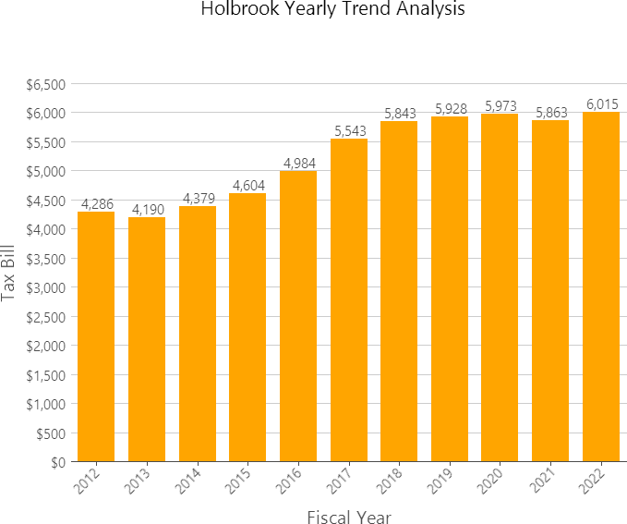
Single Family Average Tax Bill
Per Massachusetts Department of Local Services (DLS) Data Analytics and Resources Bureau

Slide 11
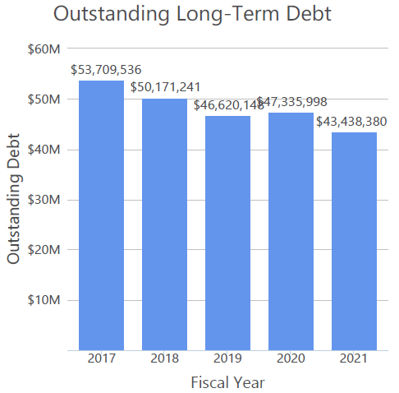
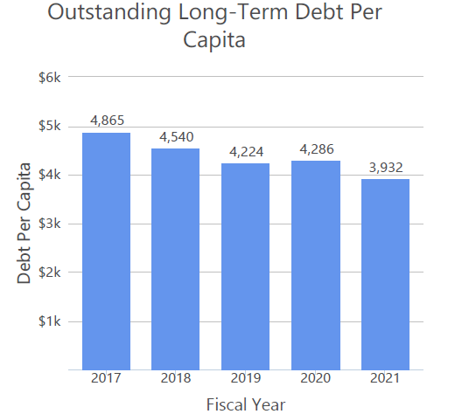
Town of Holbrook
Year | Moody's | Standard & Poor's
2021 |  | AA-
2020 | A2 | AA-
2019 | A2 | AA-
2018
2017 | A2 | AA-
2016
Per Massachusetts Department of Local Services (DLS) Data Analytics and Resources Bureau

